Slide 1
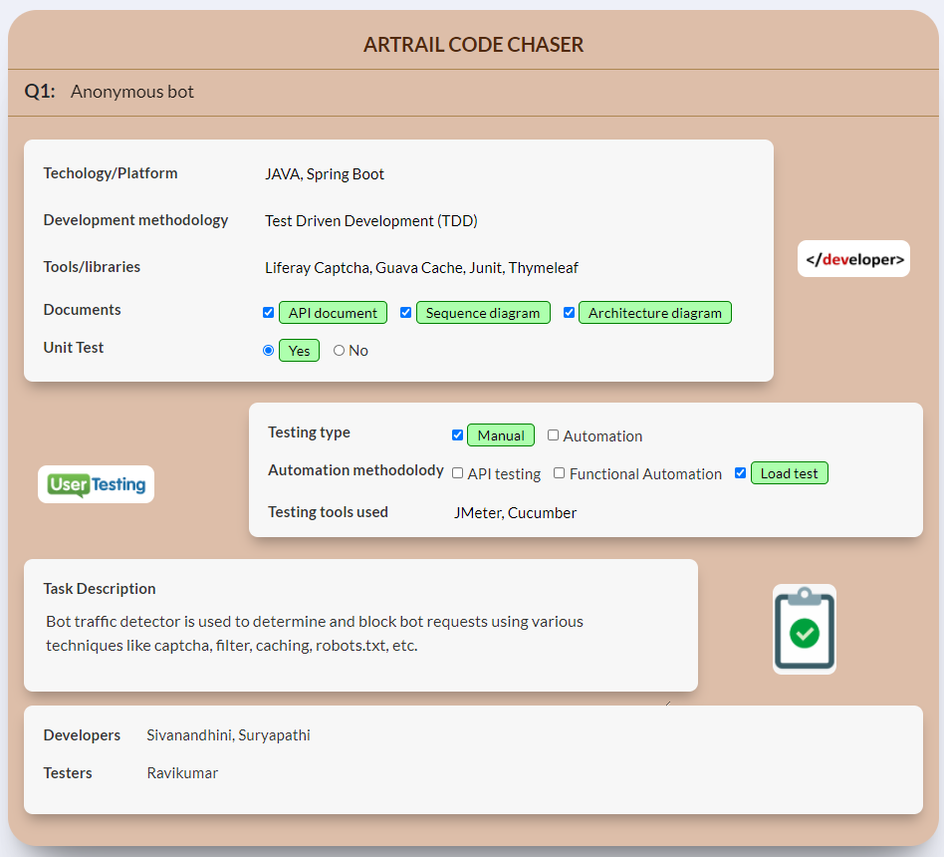

Slide 2
Detecting Bot Traffic

Slide 3
Highlights
Bots can perform repetitive tasks very quickly, at a rate that human beings simply can’t manage.
To block Bot Traffics, below techniques are handled in the application.
Forms with CAPTCHA
Prompting the user to force enter the content in the CAPTCHA to determine the request is from human or Bot.
Security Filters for API call
Detecting User-Agent details from the Request and comparing it with predefined bots in the application to block Bot request.
Calculating the maximum request count per second using IP address & to block Bot request.
Disallowing the requests by placing the robot.txt file in the application folder, we can determine & block Bot request.

Slide 4
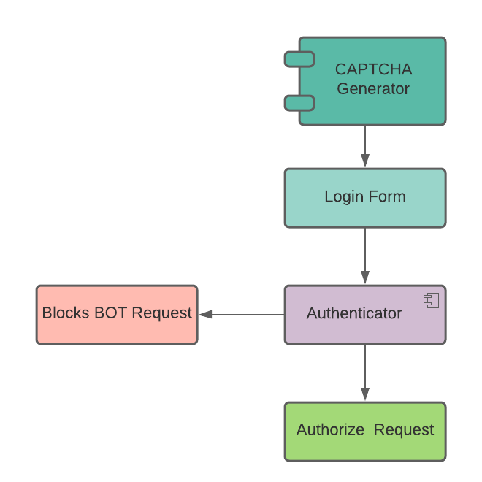
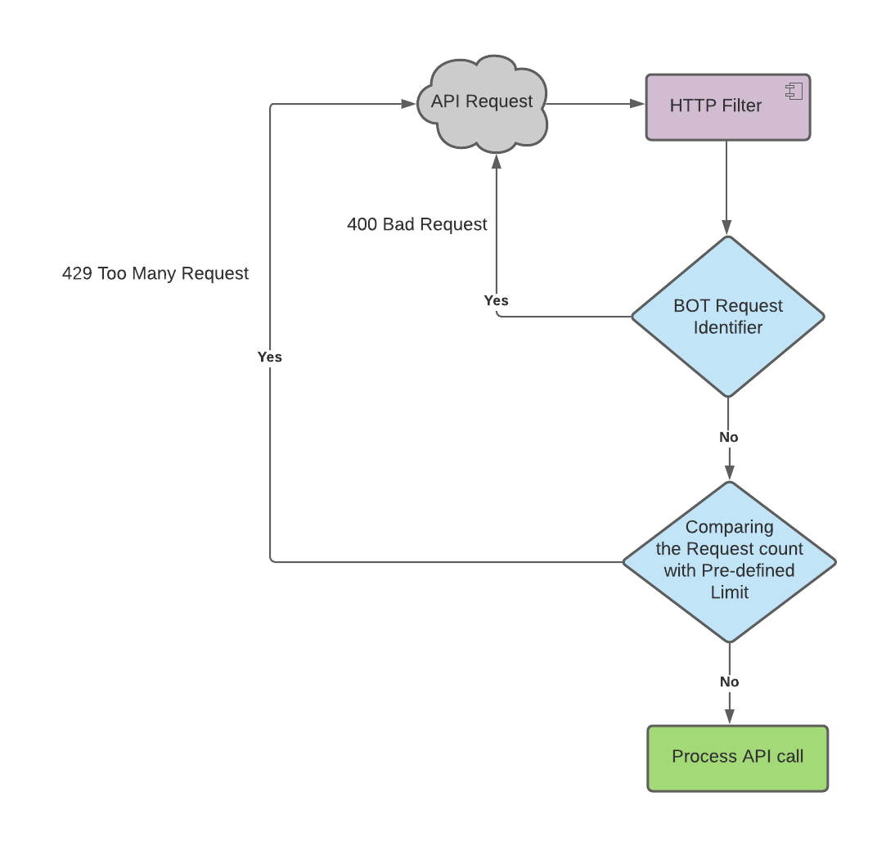
Process Flow Diagram
Forms with CAPTCHA
Security Filters for API call

Slide 5
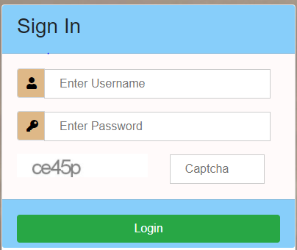
Form with inescapable CAPTCHA
Rendering inescapable CAPTCHA in the form and asking the user to submit the form with it.

Slide 6

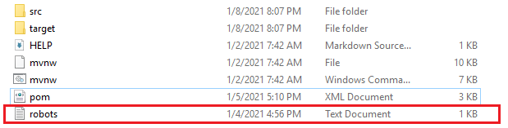
Robot.txt
The robots. txt file is known as the robots exclusion protocol. It tells web robots which pages not to crawl

Slide 7
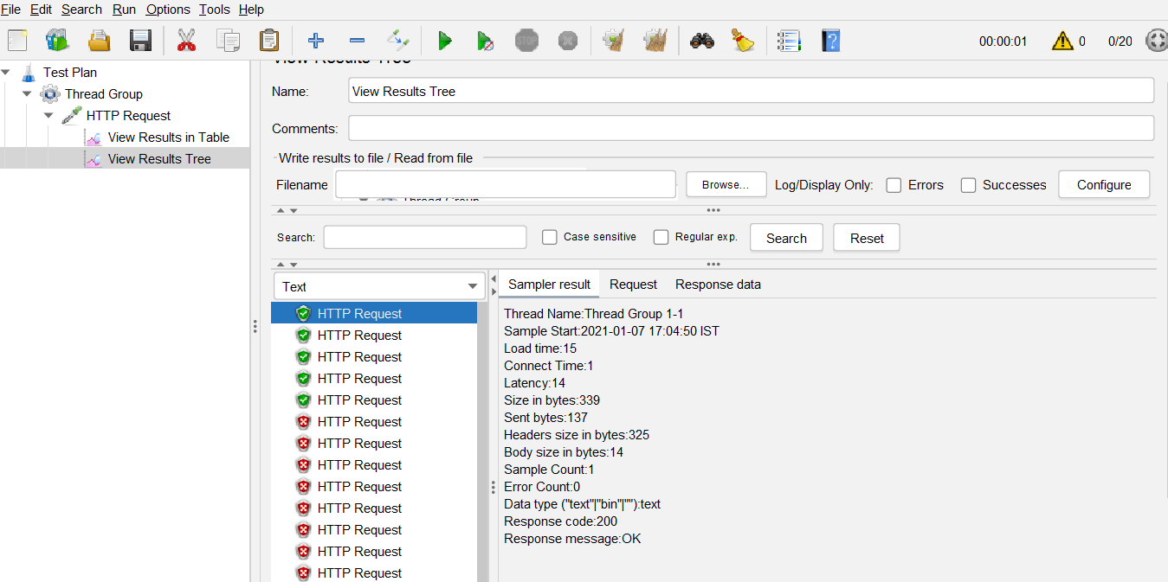
JMeter testing result
JMeter request blocked by the filter after exceeding the maximum request limit per second

Slide 8
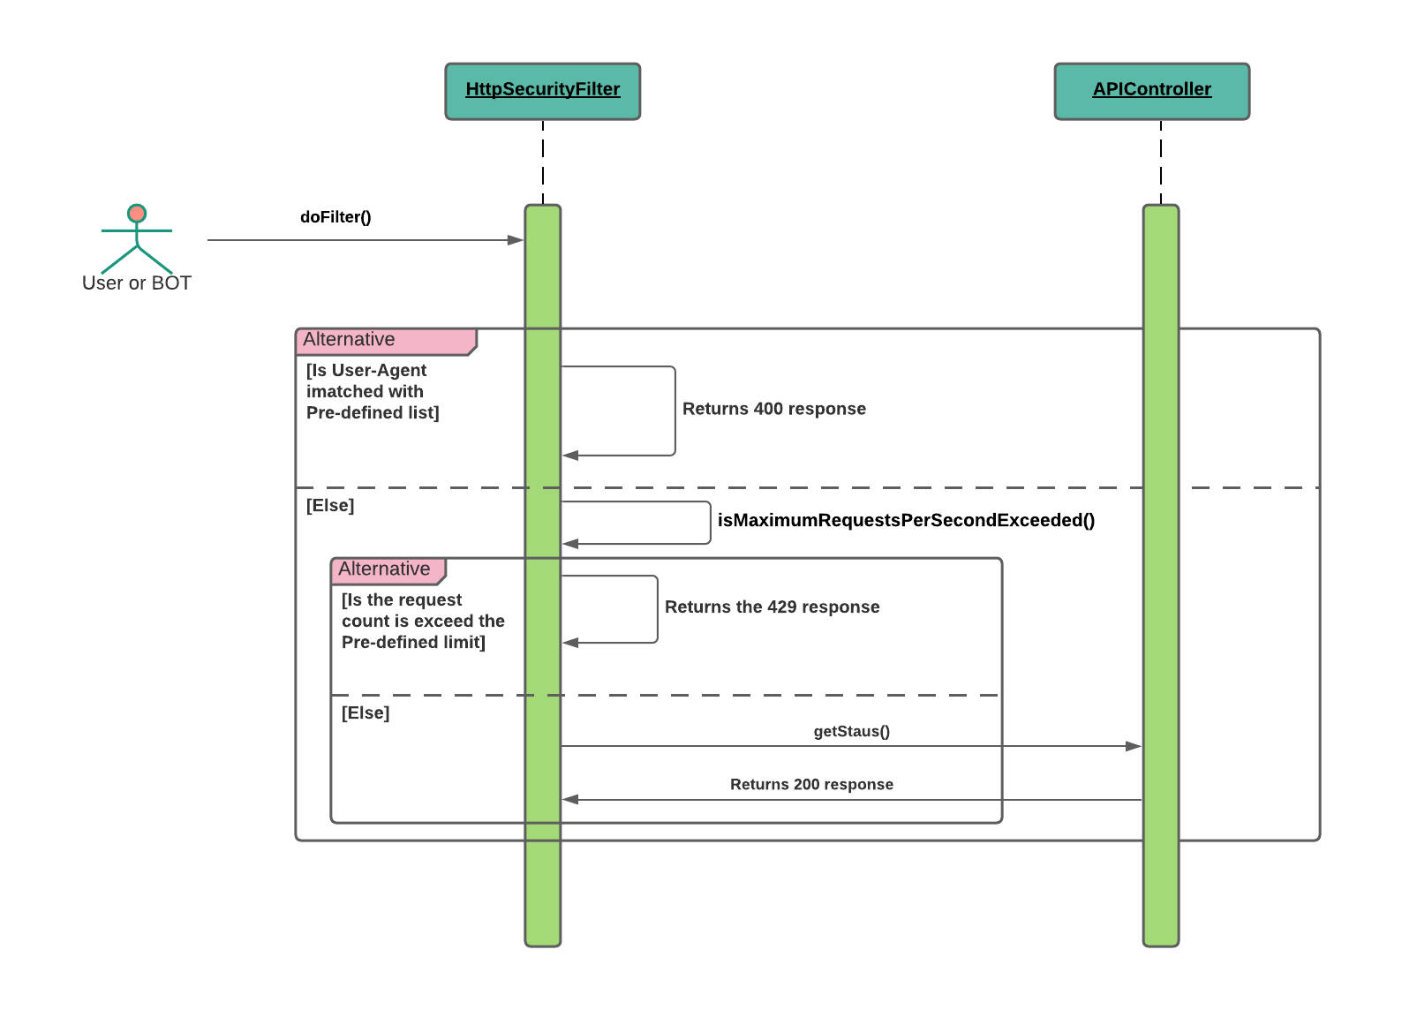
Sequence Diagram
Filtering the API call request by using various strategies.

